Slide 1
Leveraging Data Securely with Fabric and Relational DBs
Kellyn Gorman
Multiplatform Advocate and Engineer

Slide 2




Who am I?
Multiplatform Advocate and Engineer at Redgate
30 Years in the Tech Industry
DBA (Oracle, SQL Server, MySQL, PostgreSQL…)
DevOps, Analytics and AI
Cloud Migrations and High IO Infrastructure
Co-Leader for the Data Platform DEI Group
Advisor for the Data Platform WIT Group
https://www.linkedin.com/in/kellyngorman/
https://dbakevlar.com
https://x.com/dbakevlar
Various Online platforms as DBAKevlar!

Slide 3
What do I do
I’m and advocate and engineer at Redgate, plus contract with other companies as a developer and engineer.
I build technical “Legos”
I architect how technology works together.
I build products/features that fill in holes between products that exist today
I solve problems.

Slide 4
The Data Lake Conundrum
Data lakes are for data scientists, not business professionals.
ACID support is rarely available.
Data lakes are more vulnerable to data silos and data sprawl.
Data lakes don’t possess the robust security layers built into relational systems.
They often create compliance risks for certain critical data
Recent data breaches and lawsuits have demonstrated how data lakes have challenged customers who thought it simply would replace relational systems of yesterday.
Notes:
ACID=
The idea that data lakes will just replace the need to have relational databases is like saying you can build a house with just a hammer. You need more than one tool to complete the task.
Yes, someone in the audience will say, “but Fabric has the Synapse warehouse service” but that still doesn’t encompass your transactional data or referential integrity that we so often see missing from the quality data that’s required for analytics, machine learning and AI.

Slide 5
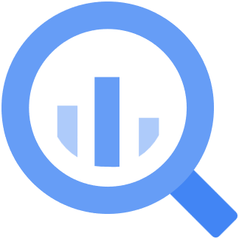
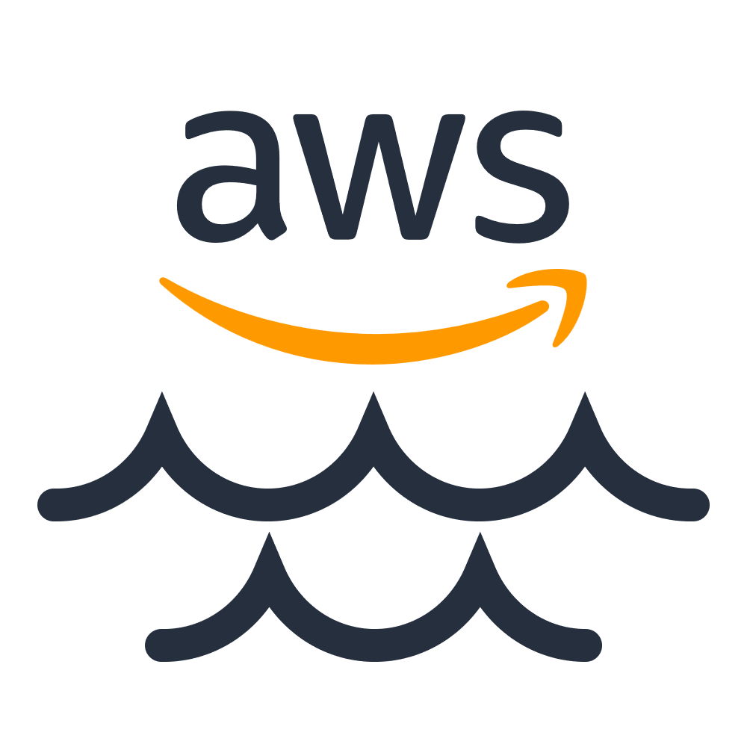

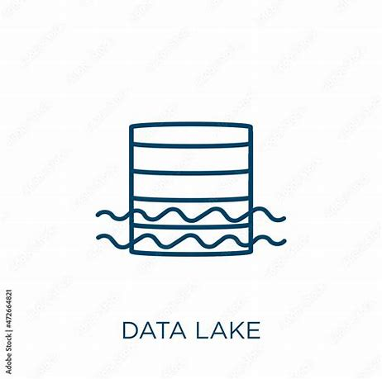
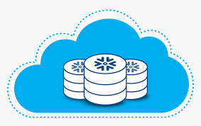
The Data Lake Conundrum
Data lakes are for data scientists, not business professionals.
ACID support is rarely available.
Data lakes are more vulnerable to data silos and data sprawl.
Data lakes don’t possess the robust security layers built into relational systems.
They often create compliance risks for certain critical data
Recent data breaches and lawsuits have demonstrated how data lakes have challenged customers who thought it simply would replace relational systems of yesterday.
Notes:
ACID=
The idea that data lakes will just replace the need to have relational databases is like sayingyou can build a house with just a hammer. You need more than one tool to complete the task.
Yes, someone in the audience will say, “but Fabric has the Synapse warehouse service” but that still doesn’t encompass your transactional data or referential integrity that we so often see missing from the quality data that’s required for analytics, machine learning and AI.

Slide 6

The Goal for this session is…
NOT to say data lakes are bad, but that you should use data lakes for the right data and for the right reasons.
Next, I will show you how to use relational databases with Fabric without impacting what it needs to do each day.

Slide 7
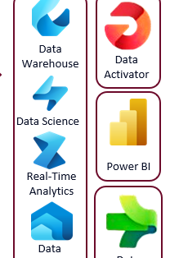

Overview of Azure Fabric and Integration to AI
What is Azure Fabric?
Key components of Azure Fabric
Services
Infrastructure
How Azure Fabric supports AI and data processing

Slide 8
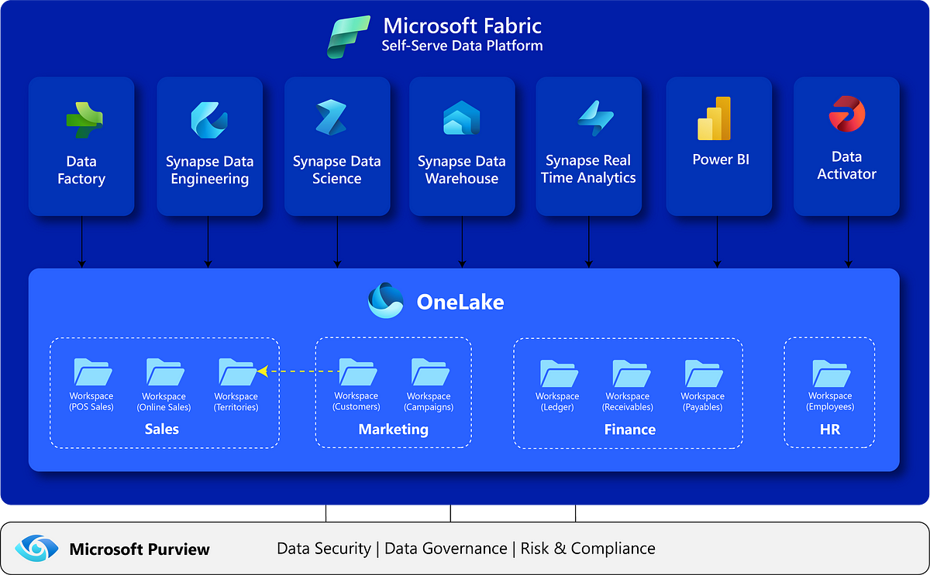
Notes:
Microsoft Fabric is an end-to-end analytics platform, and it allows Power BI, AI and other services to seamlessly interact with large-scale data, enabling advanced analytics and reporting capabilities.

Slide 9
Unified Analytics Platform
Microsoft Fabric provides an end-to-end, unified analytics platform for data ingestion, transformation, storage, and analysis. Power BI integrates directly with this platform to enable data visualization and reporting. This integration allows users to:
Access data across Data Lakes, Lake houses, and Data Warehouses managed by Microsoft Fabric.
Perform real-time analytics and create interactive reports and dashboards in Power BI.

Slide 10
Data Access and Ingestion
With Azure Fabric, you can bring data from multiple sources into the platform, such as:
Azure Data Lake Storage (ADLS Gen2) for storing raw data.
Azure Synapse Analytics for data warehousing and large-scale analytics.
Data Pipelines from sources like SQL Server, Oracle, SaaS applications, and IoT devices using tools like Azure Data Factory or Synapse Pipelines.

Slide 11
Power BI can connect directly to data through Direct Query, Import Mode, or Composite Models, allowing real-time or scheduled data refreshes.

Slide 12

Power BI Integration
Power BI is natively integrated with Microsoft Fabric, providing features like:
Auto-discovery of Fabric data models: Power BI automatically detects data models and datasets in Microsoft Fabric for reporting and visualization.
Lakehouse Integration: Power BI can connect directly to Lake houses created in Microsoft Fabric, which store structured and unstructured data.
Enhanced Performance: Power BI's Direct Query and Composite Models allow users to work with large datasets stored in Fabric without needing to move the data. This reduces latency and improves performance in handling real-time data

Slide 13
Lakehouse and Warehouse for Datasets
With Microsoft Fabric’s Lakehouse and Data Warehouse capabilities, users can easily convert these data stores into Power BI datasets. These datasets can then be used to create reports and dashboards in Power BI, making it easy to visualize data directly from your analytics platform.

Slide 14

Advanced Analytics
Power BI leverages the AI capabilities of Microsoft Fabric to provide advanced features such as:
AI-driven insights: Use Azure Machine Learning models or pre-built AI models to generate predictions or recommendations and visualize the outcomes in Power BI.
Dataflows: These can be used to pre-process or cleanse data within Power BI before connecting it to the data stored in Microsoft Fabric, ensuring clean and consistent data for analysis.

Slide 15

Collaboration and Sharing
Fabric and Power BI promote collaboration between data engineers, analysts, and business users by:
Workspaces: Shared workspaces allow teams to collaborate on datasets, reports, and dashboards in Power BI, backed by data stored and processed in Fabric.
Power BI Service Integration: Reports and dashboards created in Power BI Desktop can be published directly to the Power BI Service, where they can interact with Fabric data and be shared across organizations

Slide 16

Azure Machine Learning
Azure Machine Learning (Azure ML)
Azure Machine Learning integrates directly with Azure Fabric to support the full machine learning lifecycle, from model development to deployment and management.
Model Training: Use Fabric’s data lakes and warehouses as data sources for training machine learning models.
Model Deployment: Models built in Azure ML can be deployed as web services and integrated with Fabric for batch or real-time scoring.
AutoML: Automates the process of selecting algorithms, feature engineering, and model tuning, accessible within the Fabric environment.
ML Pipelines: Build end-to-end machine learning workflows by connecting data in Fabric to model training, evaluation, and deployment.

Slide 17

Azure Cognitive Services
Azure Cognitive Services provides pre-built APIs for incorporating AI into applications without needing extensive AI expertise. It can be integrated with Fabric to process and analyze unstructured data, automate tasks, and enhance user’s experience:
Language: For natural language processing (NLP), sentiment analysis, and text translation.
Vision: Image recognition, object detection, and OCR (Optical Character Recognition).
Speech: Speech-to-text, text-to-speech, and real-time translation of spoken language.
Decision: Services like anomaly detection and personalized recommendation
Azure OpenAI Service: Leverage large language models (LLMs) like GPT for text generation, summarization, and conversational AI

Slide 18


Azure Synapse Analytics
Azure Synapse is part of the Fabric platform, and it offers deep AI and machine learning integration, making it easier to analyze large-scale data.
Big Data Analytics: Use Spark pools within Synapse to process big data using distributed computing and integrate with AI models for insights.
Built-in Notebooks: Synapse integrates with Jupyter Notebooks for interactive data exploration and model development using Python, Spark, and machine learning libraries.
Machine Learning Integration: Models trained within Azure ML can be integrated into Synapse pipelines to run AI/ML jobs over Fabric data.

Slide 19

Azure Cognitive Search
Azure Cognitive Search can be integrated with Fabric to provide intelligent search experiences over large data sets.
AI-Powered Search: Incorporate natural language processing (NLP) to understand queries better and return more relevant results.
Text Analytics and Knowledge Mining: Use AI to extract key insights from unstructured data in Fabric’s lakehouses or warehouses.
Document Processing: Enhance search capabilities by adding layers of understanding to documents through AI-based skill sets like language detection, key phrase extraction, and sentiment analysis

Slide 20

Power BI AI Services
Power BI, as a visualization and reporting tool integrated with Fabric, also offers built-in AI capabilities that can enhance analytics:
Key Influencers: Automatically detect the factors that most influence a metric or outcome using machine learning models.
AI-Driven Insights: Use Quick Insights to identify trends, anomalies, and patterns in data without needing to manually build models.
Cognitive Services Integration: Embed text analytics, sentiment analysis, and image recognition within Power BI reports using Azure Cognitive Services.
AutoML in Power BI: Power BI can leverage AutoML to build machine learning models within the dataflows, directly integrated with Fabric’s data sources.

Slide 21

Azure Open AI Service
Azure OpenAI Service offers access to advanced large language models (LLMs), such as GPT-3 and GPT-4, for tasks like:
Natural Language Processing (NLP): Text generation, summarization, and translation.
Text Analytics: Extract information from text data stored in Fabric’s lakehouse or warehouse.
AI-Powered Automation: Generate responses or automate tasks using conversational AI and Fabric data.

Slide 22

Azure Cognitive Vision
Azure Form Recognizer and other Vision services can be used to extract structured data from unstructured documents, making it easy to analyze:
Document Processing: Extract information like invoices, receipts, and contracts from files stored in Fabric’s data lakes.
OCR and Handwriting Recognition: Leverage optical character recognition (OCR) to convert images of text into usable data.

Slide 23
Why Purview
Data Governance: Azure Purview is essential for enterprises aiming to implement comprehensive data governance strategies.
Data Lineage for Compliance: Especially critical for industries like finance, healthcare, and insurance, where tracking the lineage of data is important for regulatory reasons.
Sensitive Data Classification: Azure Purview helps identify and classify sensitive data to ensure proper handling, thus reducing risks of data breaches or non-compliance with privacy laws
This is a necessary layer to Fabric that many are missing today and most likely will be missing going forward to classify data and eliminate data vulnerability.

Slide 24
Now that we know all this, what IS common architecture?

Slide 25

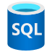




Azure Service Fabric
Notes:
Relational database feeds traditionally are expected to feed into Fabric and then use Stream analytics or ADF to load into One Lake, SQL Warehouse or LLMS. From here, machine learning, Synapse and such are used, with end users accessing data from Power BI in the Power Platform, Azure machine learning studio, Azure AI Studio and Azure AI Open AI services.

Slide 26
Data Security In FAbric
Encryption: Data in OneLake is encrypted at rest by default using Microsoft-managed keys. Encryption is transparent and FIPS 140-2 compliant. TDE exists, but without Customer-Managed Keys.
Role-based access control (RBAC): You can define security roles that grant read access to specific folders within a Fabric item. You can then assign these roles to users or groups. Fine-grained controlled don’t exist at this time and are quite broad. No row-level security exists. Column-level security requires complex work arounds.
Auditing: Activity can be logged, but limited and nothing around what records have been accessed, etc. It’s not at the level to meet SOX or HIPAA requirements.
Networking: Understanding private endpoints are essential to ensure vulnerabilities at the network layer aren’t introduced. No DDoS protection at this time exists.

Slide 27
RDBMS Security
Transparent Data Encryption (TDE): Encrypts data at rest in the database, making it difficult for attackers to read directly from storage. This is available on top of host-level encryption or network encryption.
Data Redaction: Dynamically masks data as it's selected from the database, based on conditions like IP address, program used, or time of day.
Strong authentication: Helps protect against unauthorized access to the database. MFA and other authentication is secondary to this and included at the IaaS layer.
Network encryption and authentication: Integrates with network encryption and authentication solutions and additional to what is offered in Fabric, along with DDoS protection offered IaaS.
Key Vault: Manages encryption keys and secrets, including passwords, SSH keys, and Wallets.
Role-Based Access: down to the column and row level, not just the table or folder level.
Multi-level Configuration: Relational Systems have a logical and physical file level, meaning that the data requires a client to access the logical data, unlike text files.

Slide 28
Why Not Just Use the Production Database?
Already supporting transactional or legacy demands.
Scaling for analytics isn’t cost-effective.
Data loads can be time consuming.
Data in relational systems may need to be denormalized.
Storage and network latency.

Slide 29
Why Not just Use Mirroring?
Azure data mirroring is a low-latency replication of your data into Azure Cosmos DB.
It creates a continuous and incremental copy of your data, without affecting your transactional workloads on the source database or container.
CosmosDB has RBAC, but the granularity of control is very limited- much too limited for sensitive data.
It uses two keys for access to the database. As these provide full access, if they are compromised, they can expose the entire database. Frequent key rotation is a requirement.
It only uses basic encryption and lacks DDoS protection natively.

Slide 30

Understanding Clones and Snapshots
Snapshot in time
Can be thick or thin- what does that mean?
Instantaneous.
Can be application consistent or storage consistent.
Notes:
A storage volume snapshot is a point-in-time, read-only or if the platform allows- read/write, copy of a storage volume (e.g., block storage, file system, or cloud storage) that captures the data and the metadata of the volume at that specific moment. Snapshots allow users to quickly revert to a previous state of the storage volume without affecting ongoing operations or requiring a full copy of the data.
Why is this important?
Thin vs. thick volume cloning, storage savings.
Very little to no impact on performance of the source system.
Can simply drop and mount a new copy in minutes, (max)to refresh data.

Slide 31
Why Use Clones or Snapshots for Fabric?
Data security policies
Data timeliness
Data sprawl
Data access control
X

Slide 32
What Is Snapshot Replication
Physical copy of data from storage or native database solution.
Ensures workload is using resources outside of production system.
Requires refresh or resync of data on regular interval.
May use masking or subsetting in conjunction with snapshot process.
Can also be referred to as a clone, but cloning can be numerous technologies- read up on the specifics.

Slide 33
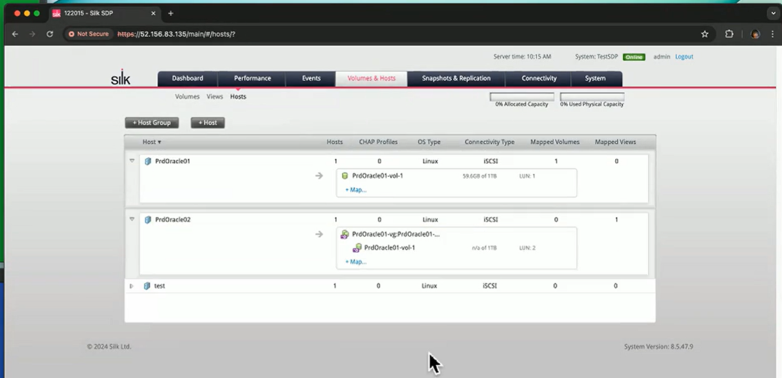
Snapshots/Instant Extracts
Creating and managing snapshots in Azure can be done from command line or User Interface, but are simply a pointer to a golden copy:

Slide 34
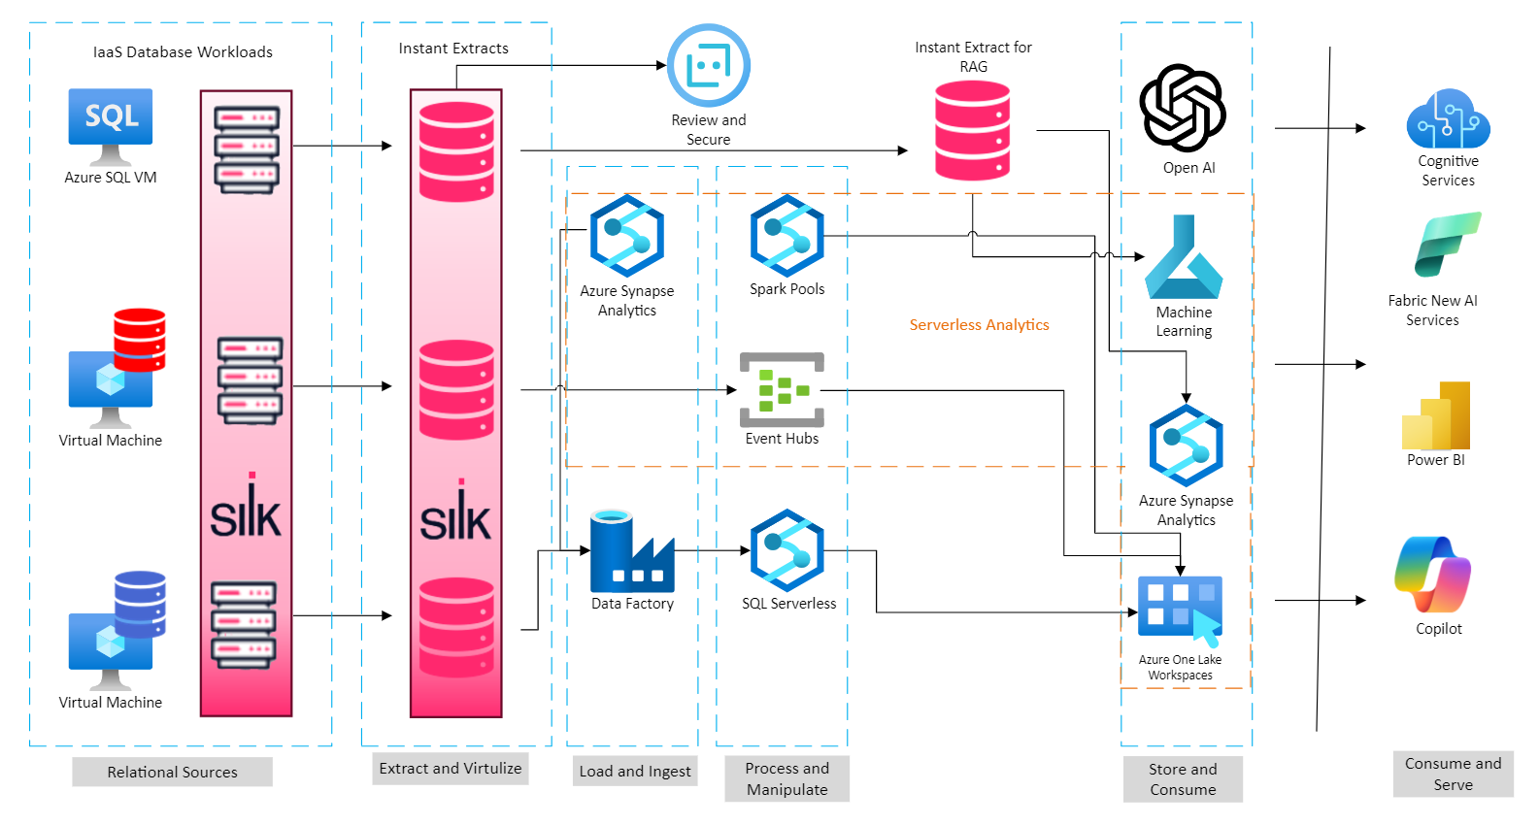
Integrating Extracts to Fabric

Slide 35
Snapshot Replication for Fabric
Identify frequency for real-time data analysis requirements.
Goal should be to keep replication as complete and as simple as possible.
The more granule changes to data from the source, the more challenges that will be faced.
Consider data types and encryption that may not be supported and how a snapshot can continue to support all relational demands that exist in the main database.

Slide 36
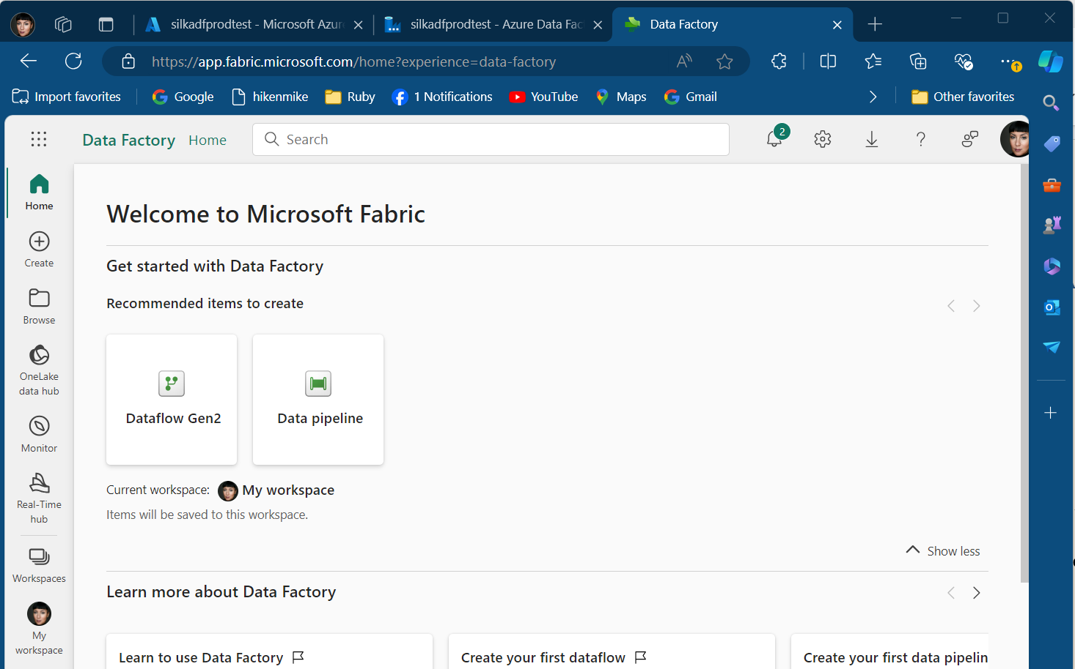
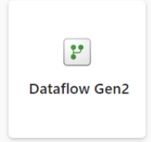
Connecting to an Instant Extract

Slide 37
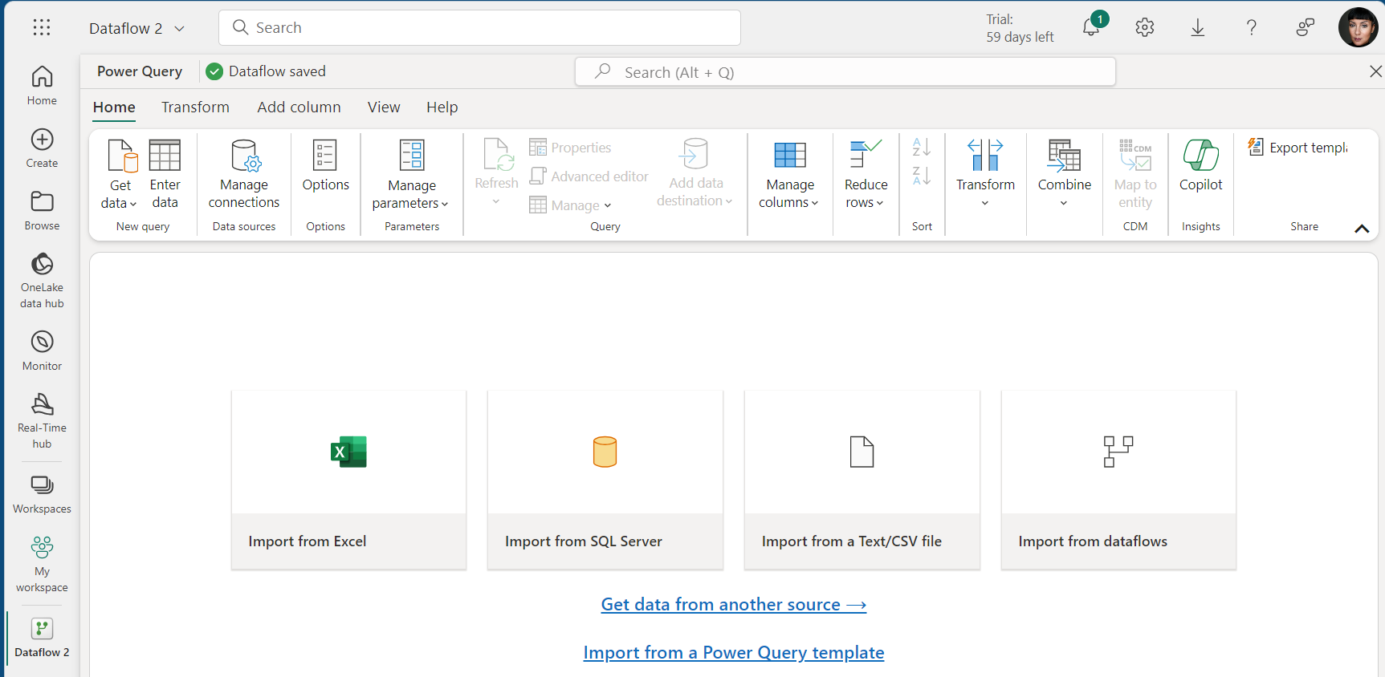
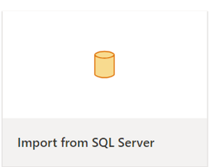
Just Like any other Database!

Slide 38
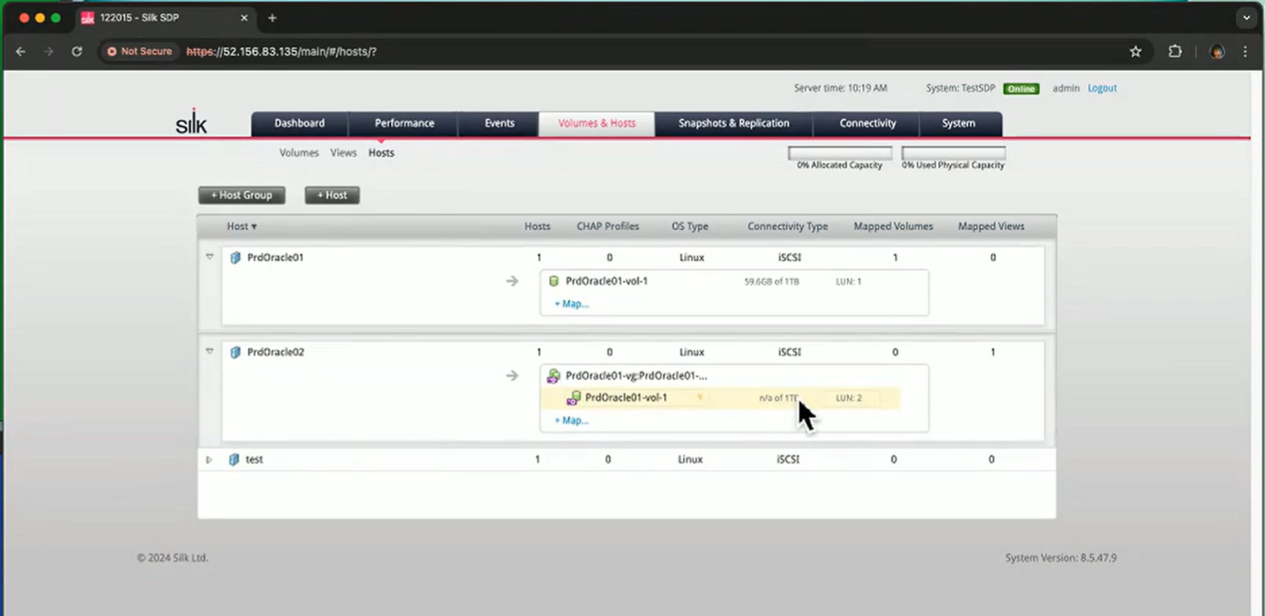
Choose the Instant Extract
The snapshot must already be attached to a VM and available.

Slide 39
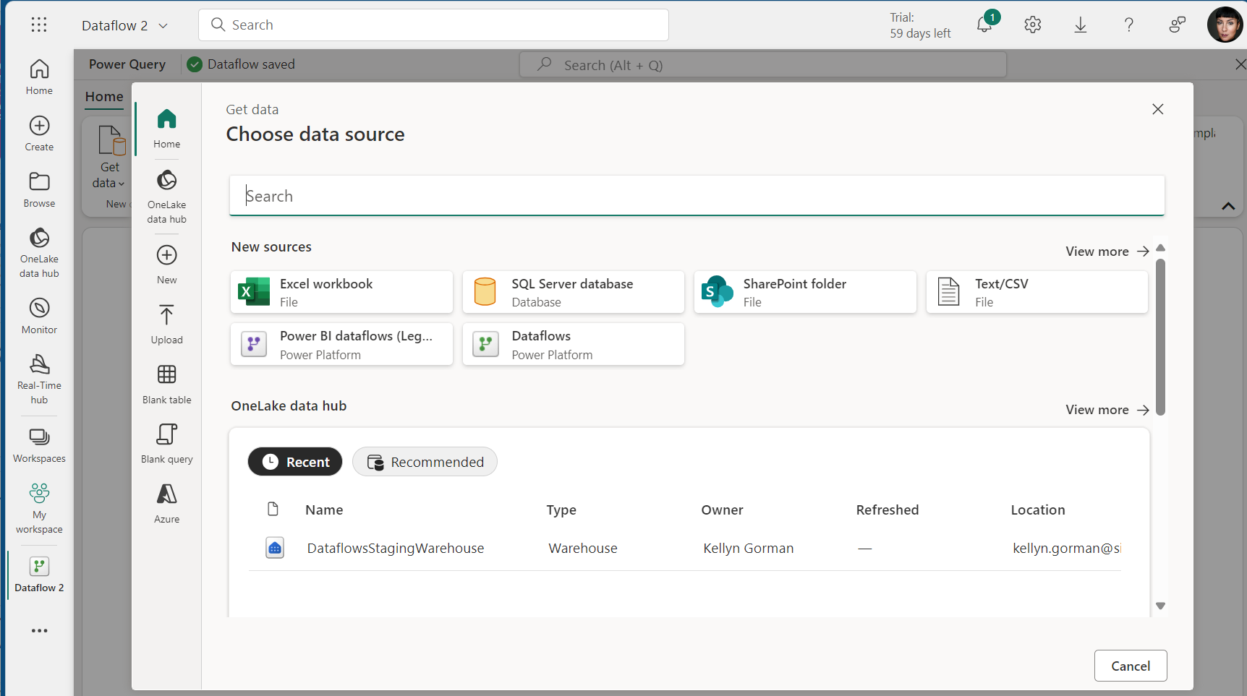
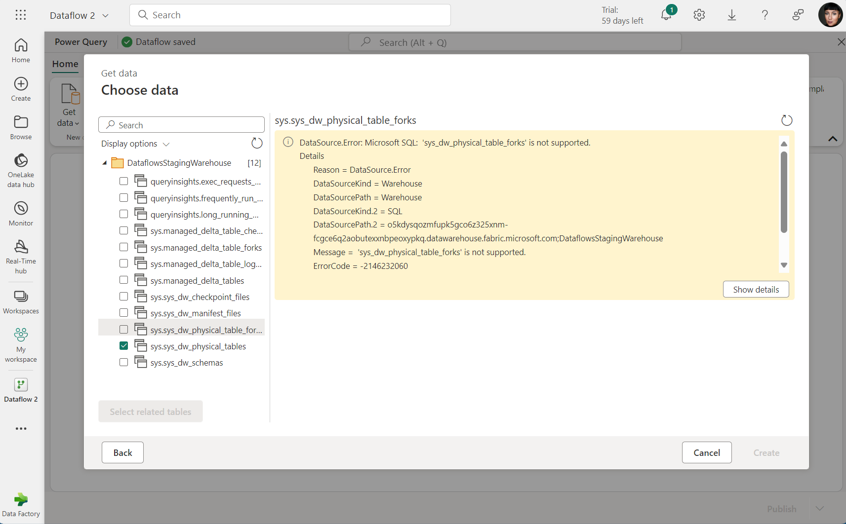
Using New ADF Gen2 with SQL Server on VM-

Slide 40
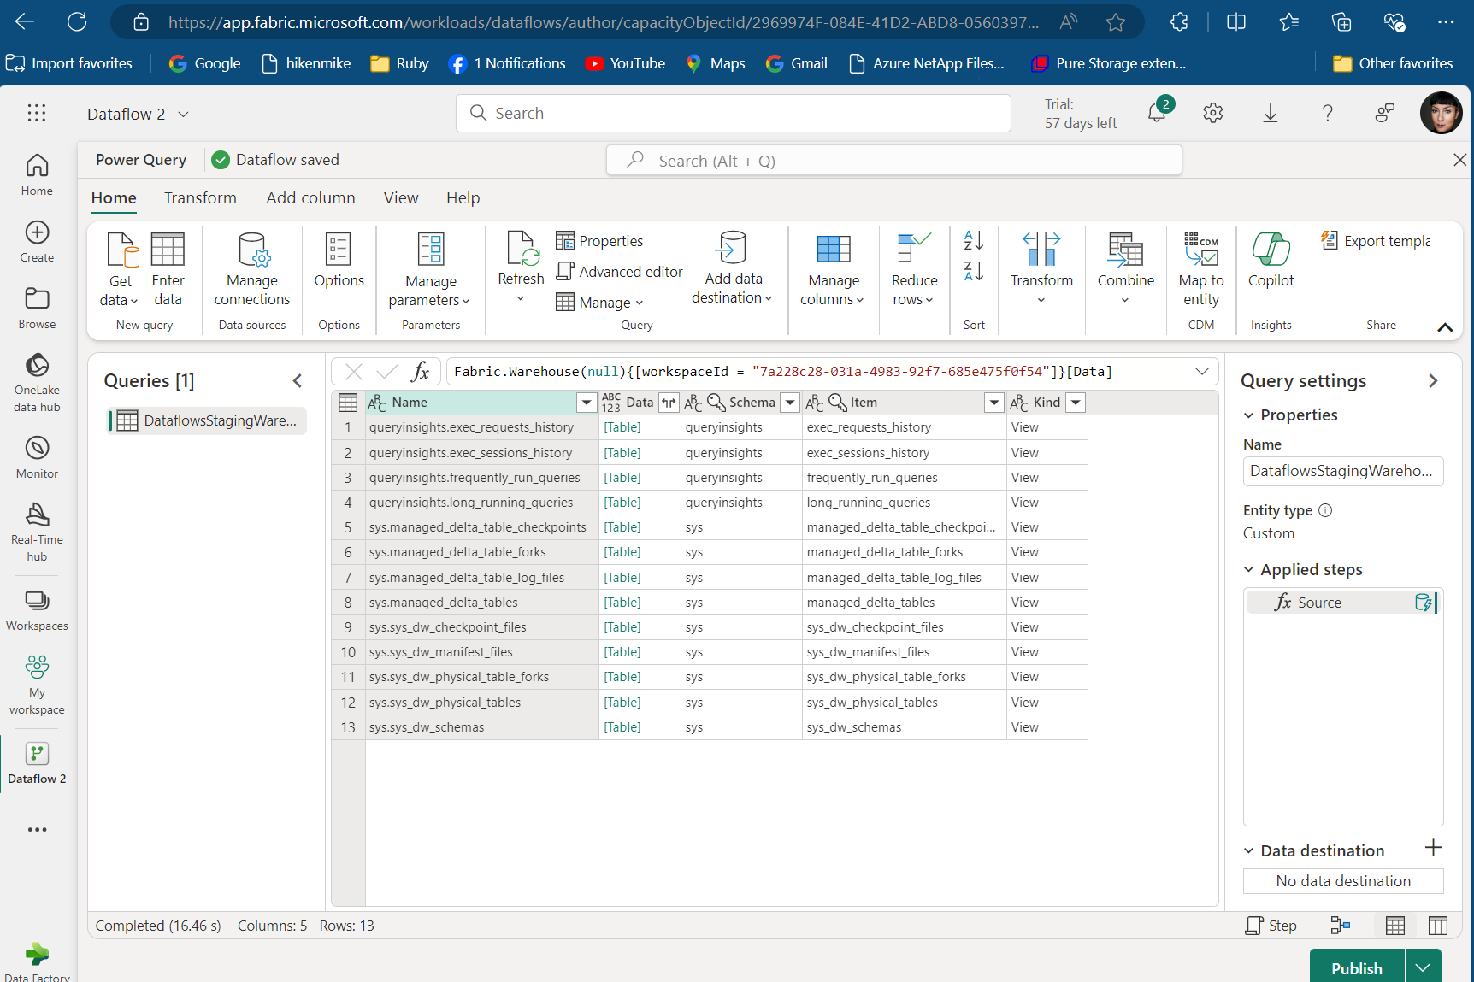
If at first, you don’t succeed…reboot
Rebooted PC after weekend and upon restore of browser, data was available in Fabric!

Slide 41
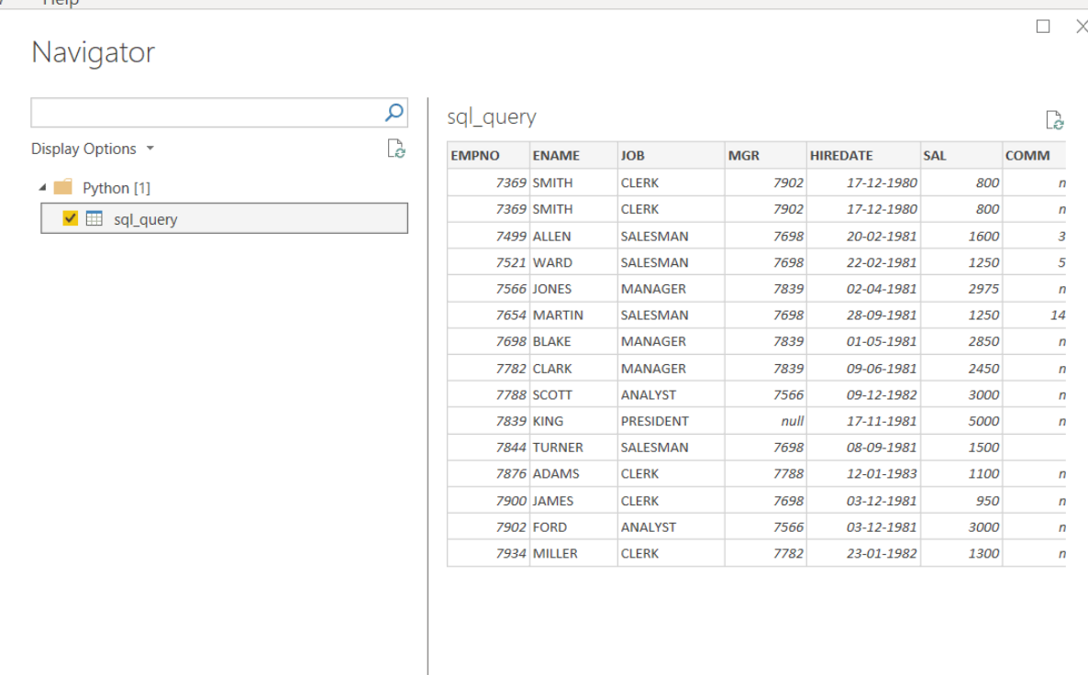
Load Data to Power BI

Slide 42
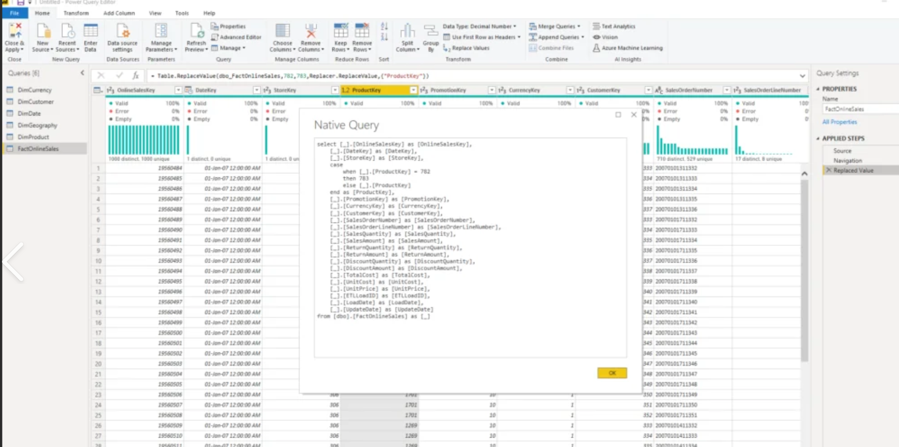
Format Dataset

Slide 43
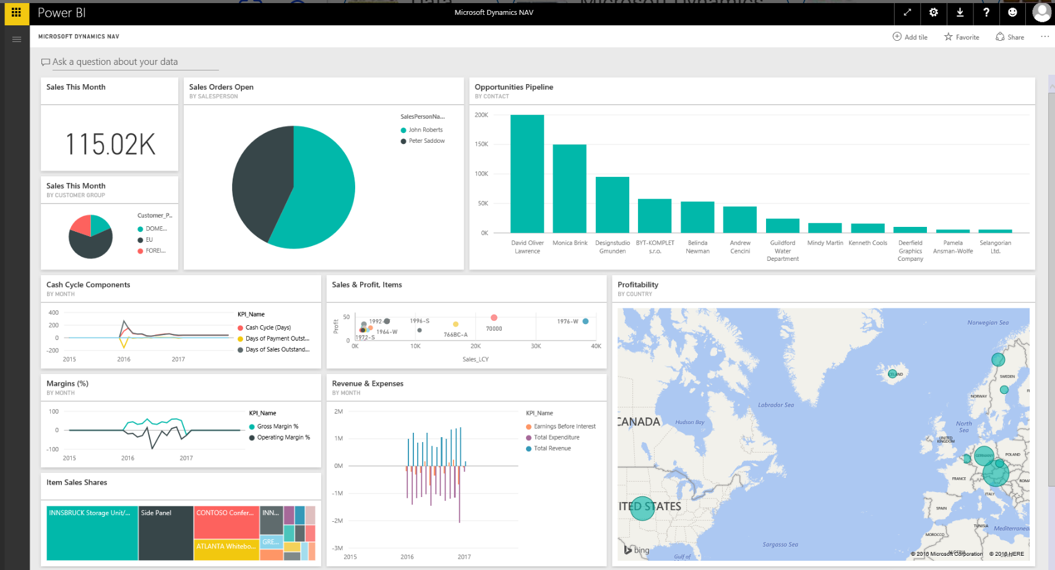

Present Dashboard with AI

Slide 44
Using Instant Extracts for RAG

Slide 45
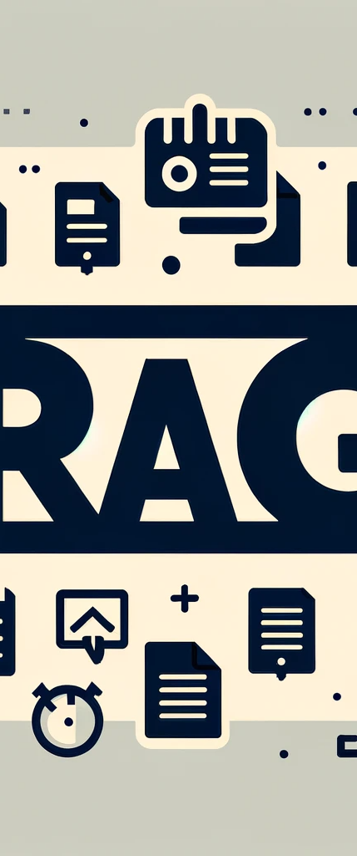
Why Use Instant Extracts for RAG
Critical data is retained in relational systems.
Can isolate critical data and mask or redact as required for isolated model training.
With microservice and AI deployment, can isolate for masked data to develop and test without exposing PII, HIPAA or other critical data.
Notes:
Retrieval Augmented Generation (RAG)
An AI framework that combines information retrieval systems and generative language models (LLMs) to create more accurate and relevant text. RAG works by using search algorithms to query external data, such as databases, knowledge bases, and web pages, and then integrating the retrieved information into the pre-trained LLM. RAG models can be more accurate, better at synthesizing information, and easier to train.

Slide 46
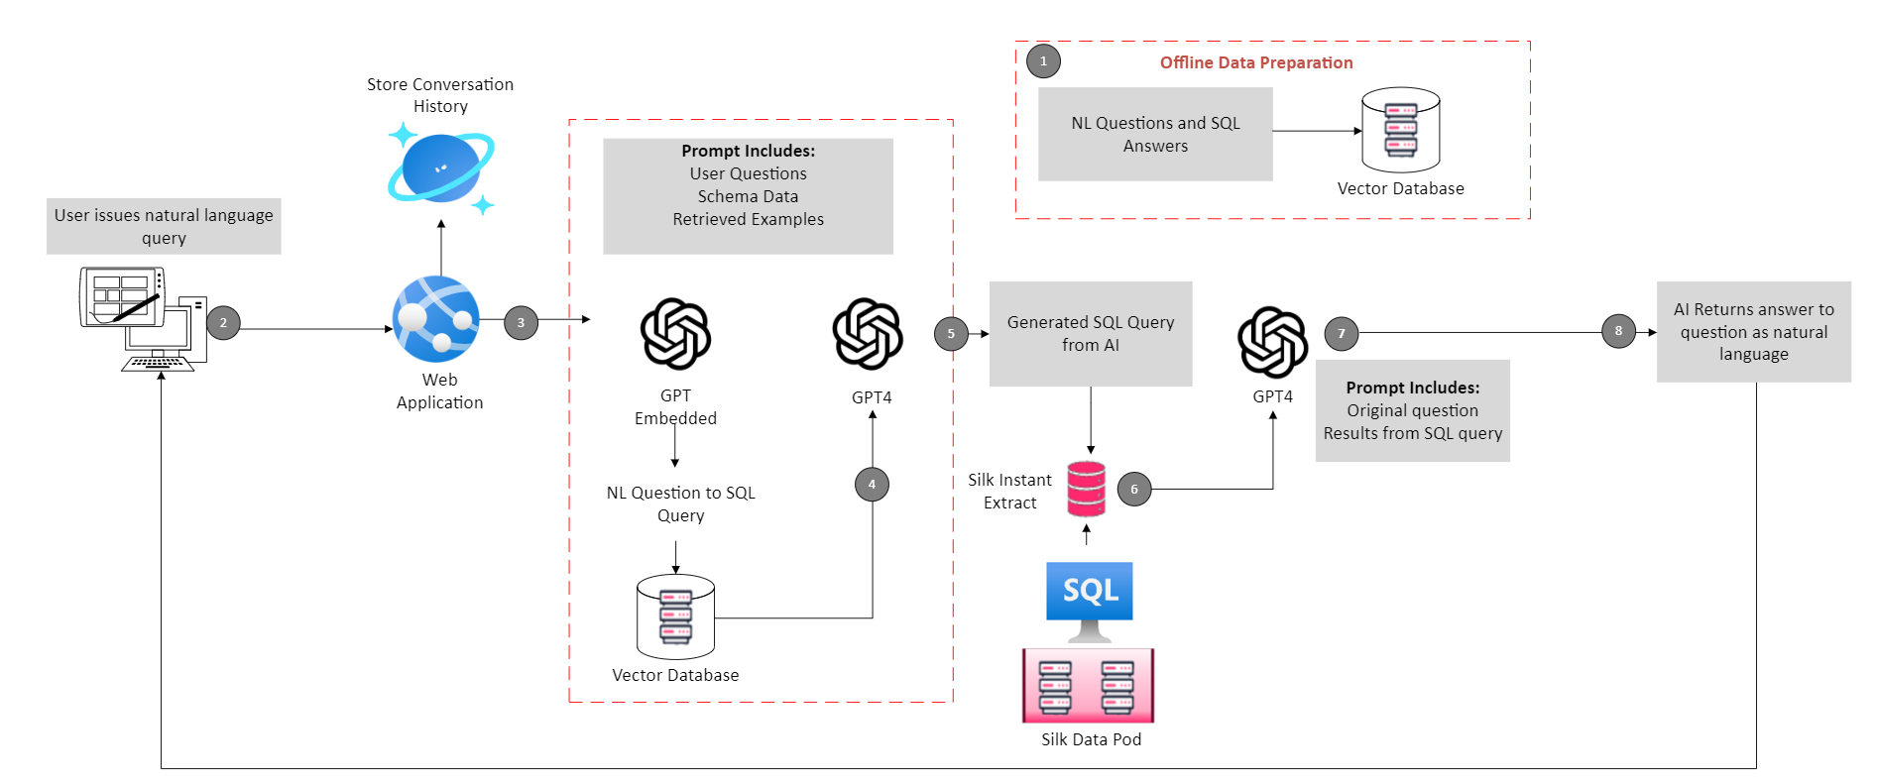
RAG Processing with Extracts
For dev and training, this extract could be masked to protect critical data
Notes:
Retrieval Augmented Generation (RAG)
An AI framework that combines information retrieval systems and generative language models (LLMs) to create more accurate and relevant text. RAG works by using search algorithms to query external data, such as databases, knowledge bases, and web pages, and then integrating the retrieved information into the pre-trained LLM. RAG models can be more accurate, better at synthesizing information, and easier to train.

Slide 47
Execution Timings Using Different Delivery Methods​
Timing for data delivery from classic through instant extract options.
Metric​ | Comfort Level | Target​ | Actual​
PowerQuery Direct query of RDBMS | PowerBI Specialist | 15 | 60
Database Mirroring and then direct to mirror | DBA | 60​ | 75​
Azure Data Factory and query Fabric workspaces | Integration Specialist | 60 | 95
Instant Extracts with Powerquery to instant extract | DBA or Cloud Admin | 5 | 8
*AdventureWorks DataWarehouse Used
Notes:
Future will hopefully have a UI included with quotas set up for the developer, tester, data scientist
Will be able to self-service instant extracts to use with dev, test and AI.

Slide 48
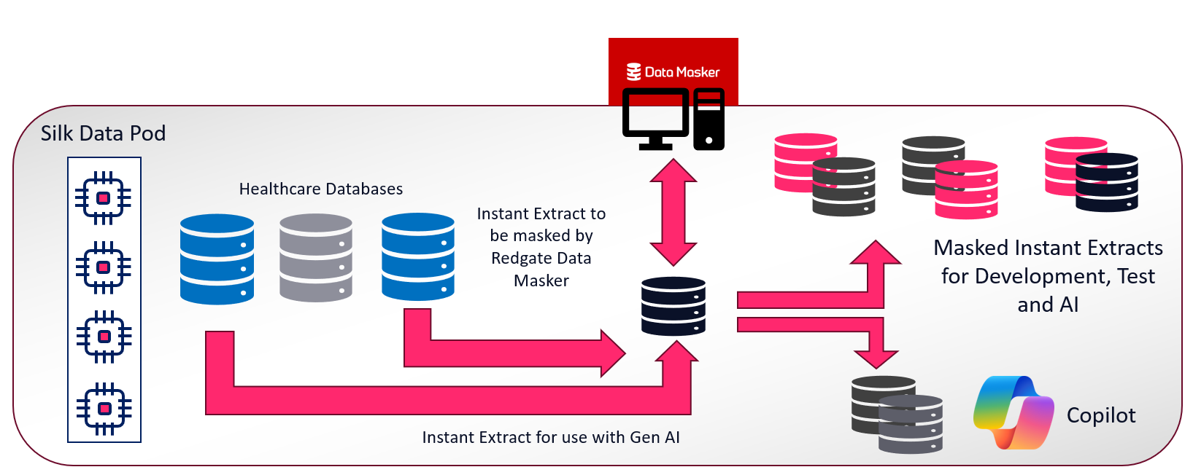
Real-World Examples
Major Healthcare Provider
Relational data is fed from EPIC and Clarity patient databases via instant extracts.
Data is masked before instant extract copies are used for development and testing.
Third set of instant extracts are used for use with Azure AI services in Fabric but queried directly due to policies that critical patient data does not leave relational database systems.
Encryption is used in flight and at rest.
All AI development and testing is done in isolated systems to protect from poisoning production AI LLMs.

Slide 49
Final tips & takeaways​
Consider the criticality of the data that you’re working with.
Use the right tool for the job.
Relational data can be retained and used in conjunction with Fabric and use zero-footprint
Quick refresh options for analytics and AI processes.
Secured, masked data for AI, and honestly, ALL development, testing and training.

Slide 50
THANK YOU
Questions?
Kellyn Gorman
Director of Data and AI, Silk
dbakevlar.com
Kellyn.Gorman@silk.us
@DBAKevlar

